Slide 1
Exploratory Visualization:
Finding Insights
JOUR479D/779D
University of Maryland
Notes:
Before there is the story, there’s figuring out what the story is.

Slide 2
Three Scenarios for Exploration
Investigative Journalism
Finding an insight in data
Exploration for Communication
How to best convey an insight; What are options?
Exploration by End-User
Finding something that is end-user relevant

Slide 3
Investigative
Before there is the story to tell, there’s figuring out what the story is to begin with.

Slide 4
How do you make sense of
1M+
Doctor’s reviews on Yelp?
Notes:
Let’s consider a specific case here where we have a massive dataset of doctor’s reviews.

Slide 5
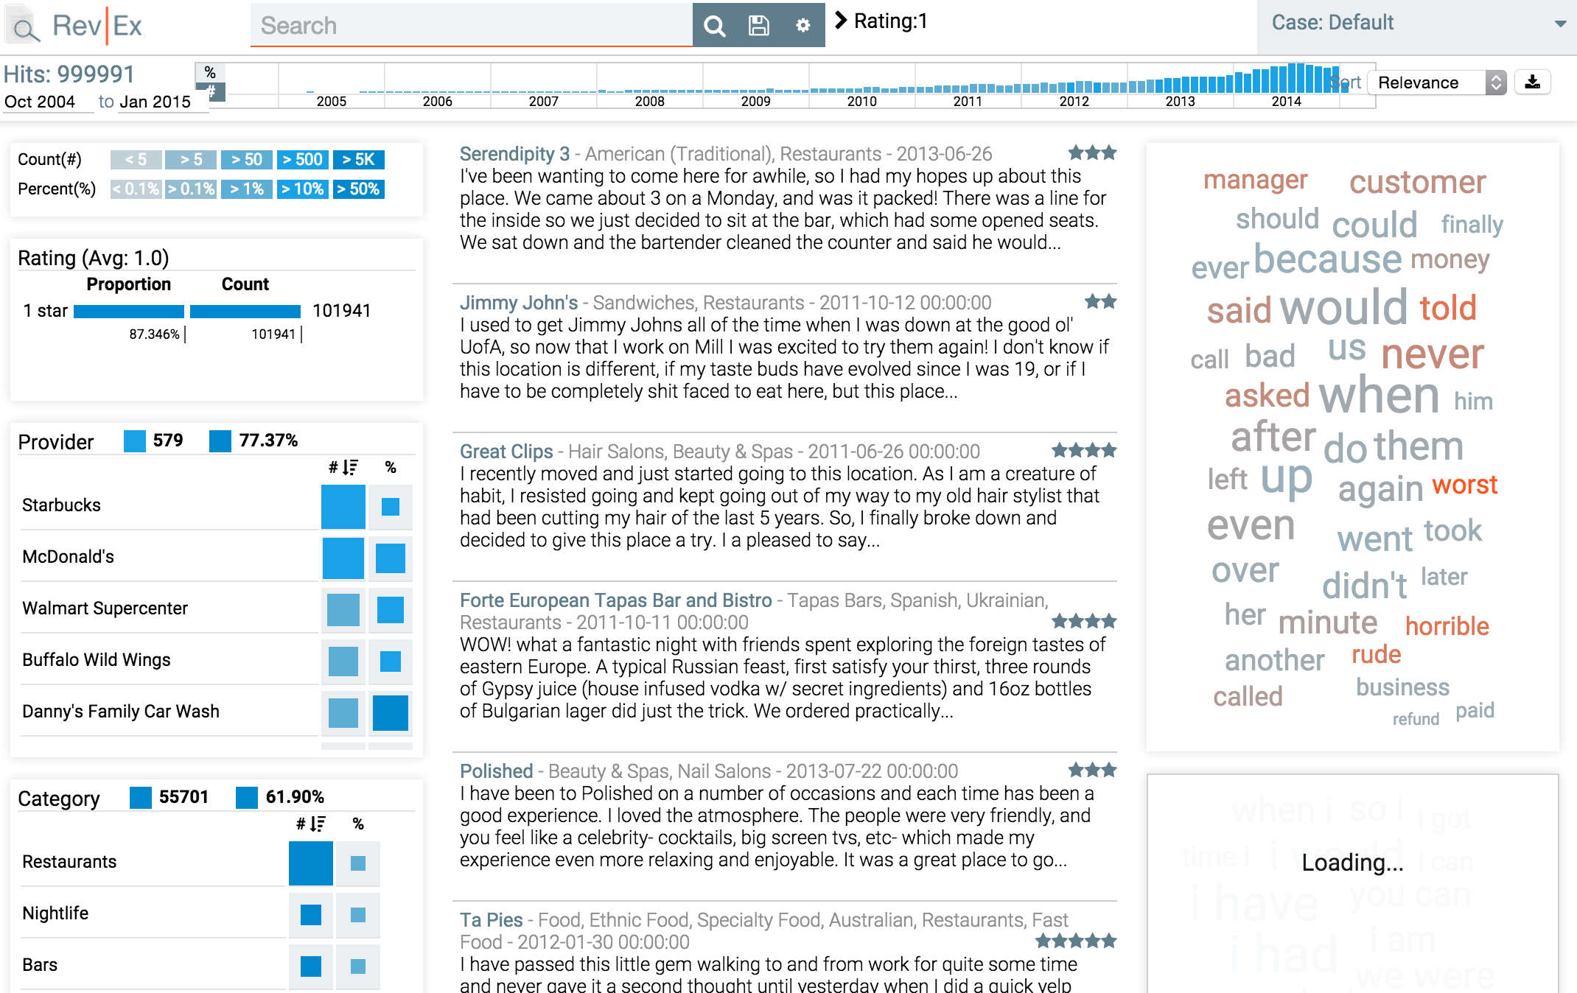
RevEx
http://nyuvis.github.io/revex/
Notes:
Rev Ex from NYU Poly – v/a to understand yelp review data. Collaborated with ProPublica.
http://nyuvis.github.io/revex

Slide 6
Investigative Exploration
Although Yelp’s health reviews date back to 2004, more than half of them were written in the past two years
Providers with the highest number of reviews generally have poorer ratings
Negative reviews are very often due to problems with customer service and staff behavior
Search for key terms like “HIPAA”
Specific cases: Western Dental's average rating of 1.8 stars on Yelp is well below the average of 4 for all dentists nationwide. About 1,250 of its 3,000 reviews used the words "wait" or "waiting" and about 15 percent of them, the word "worst."
http://www.npr.org/sections/health-shots/2015/08/06/429624187/on-yelp-doctors-get-reviewed-like-restaurants-and-it-rankles
Notes:
End story doesn’t even necessarily have to be visual, but visualization helps you get the insights that drive the story.

Slide 7
Finding Newsworthy Insights
“So what” test?
Why does this insight matter and to whom? Impact & consequence? Significance and magnitude?
Factors
Timely
Proximal
Rare, Surprising
Exposes Controversy
Scandal
Extremes
Good / Bad News
Entertaining
Powerful people, Celebrity
- Harcup & O’Neill. What is news? News values revisited (again). Journalism. 2016.
Notes:
Different domains will have different demands on the kinds of insights you’re looking for in the data. In Journalism this is influenced by a set of newsworthiness values

Slide 8
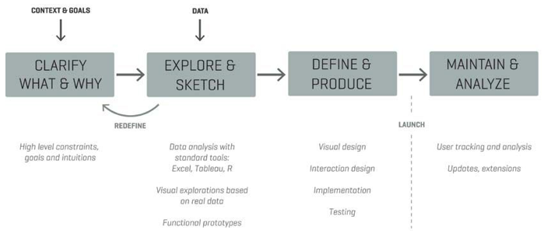
Exploration for Communication
- Moritz Stefaner
Notes:
Exploratory visualization is part of a process for figuring out what you want to communicate, as well as HOW you want to communicate it. You can rapidly explore different options.
It’s an important component to the design process. It’s also what we’ll focus on here.

Slide 9
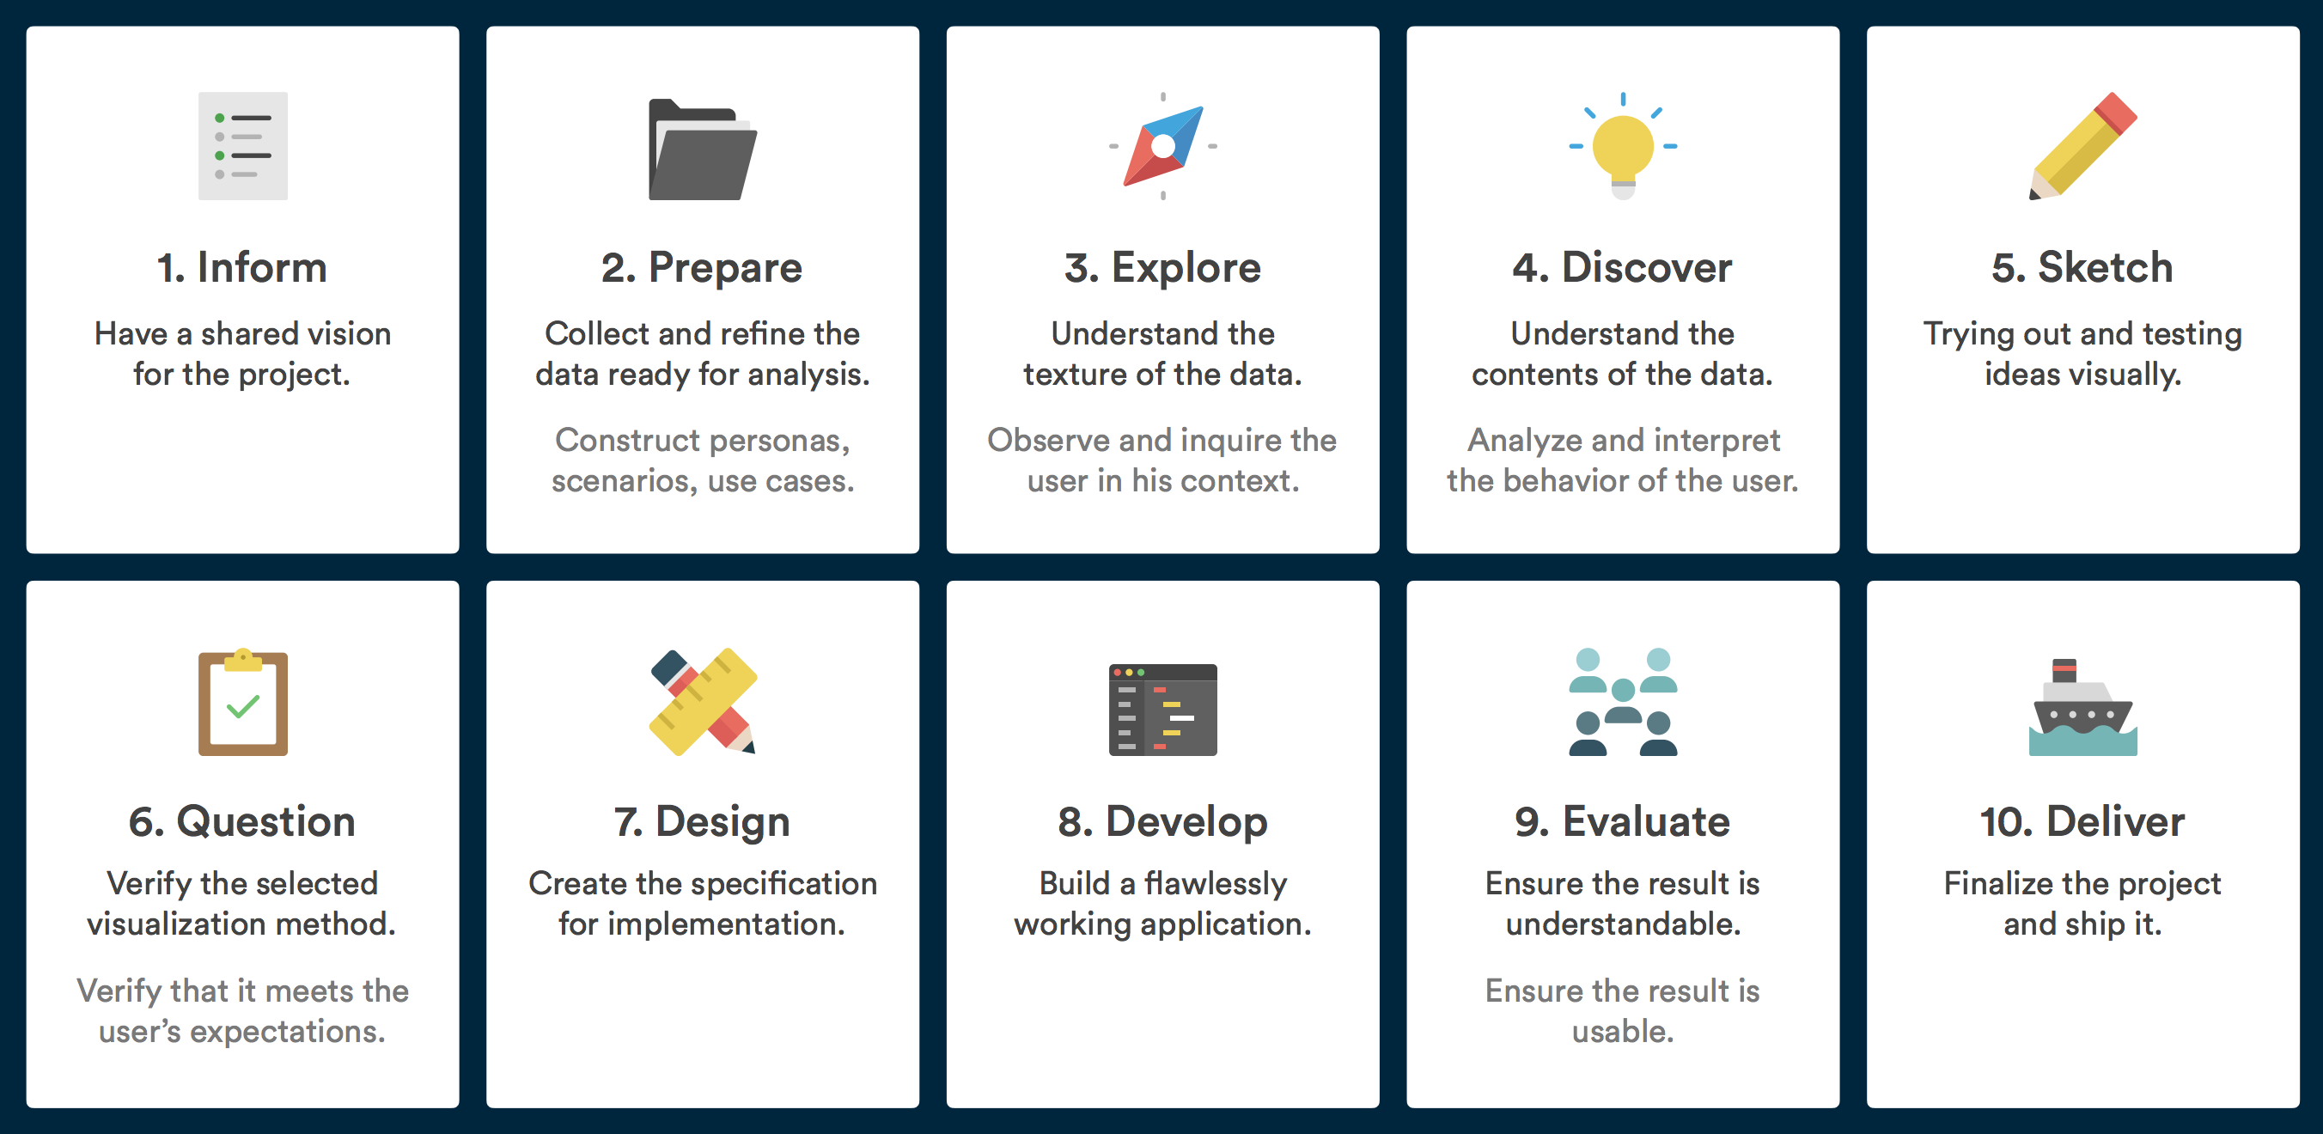
Exploration for Communication
- Benjamin Wiederkehr
Notes:
A different model for the visualization process from Wiederkehr also heavily emphasizes exploration and discovery before moving on to sketching and design.

Slide 10
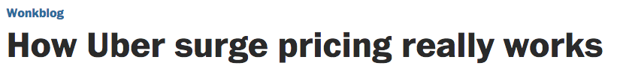
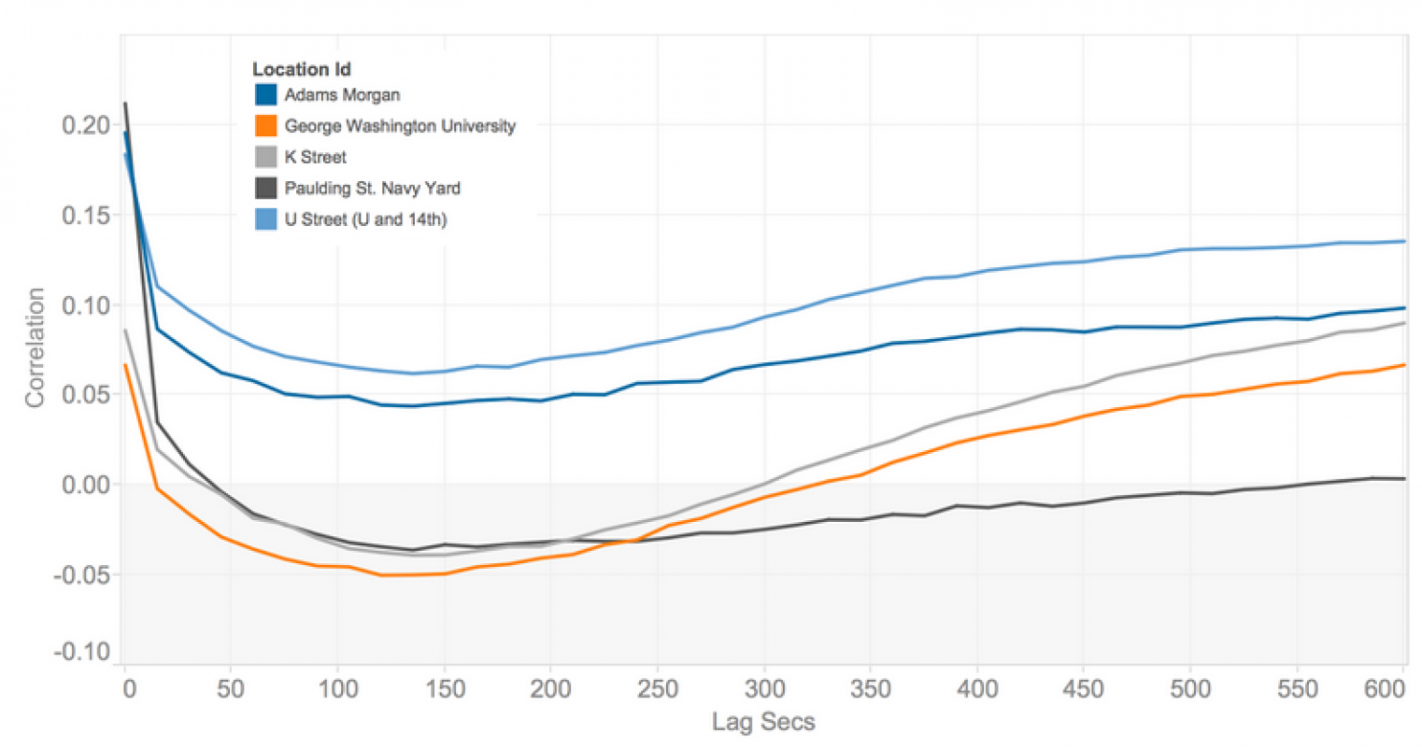
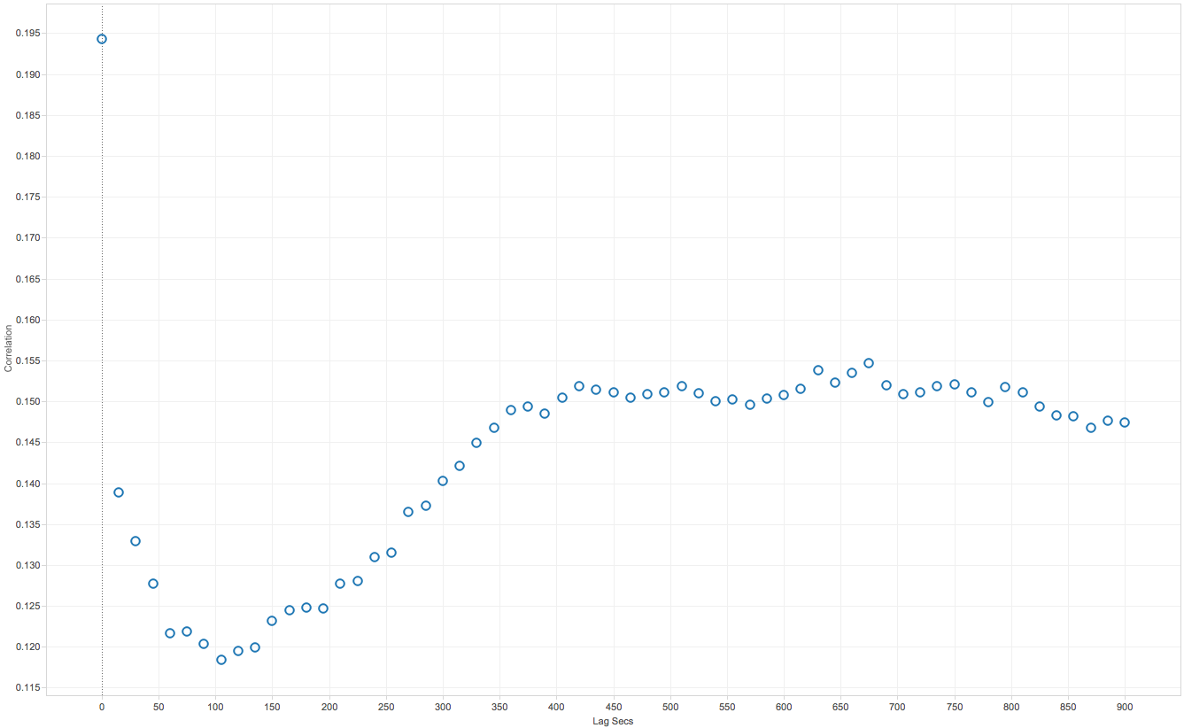
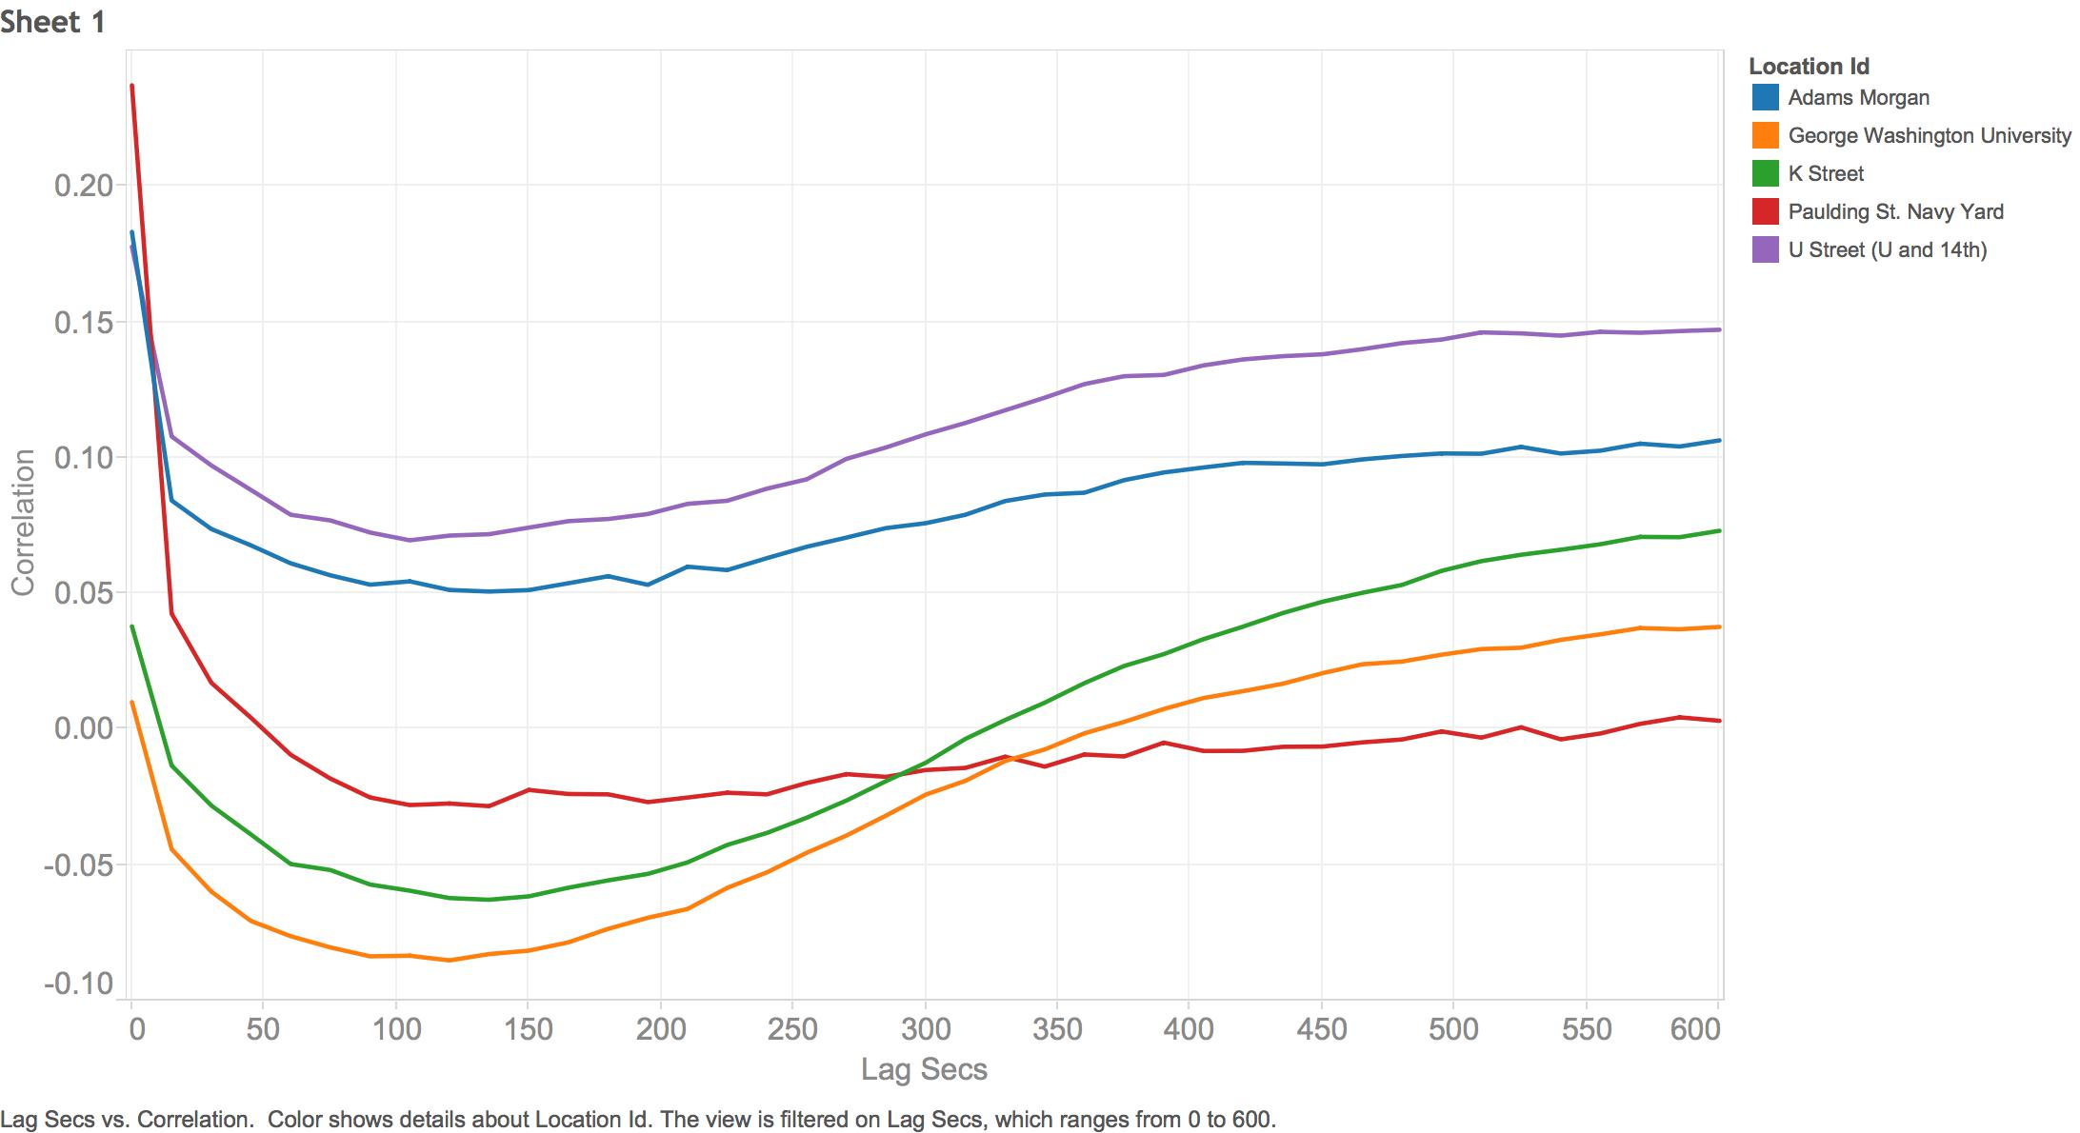
Exploration for Communication
http://www.washingtonpost.com/news/wonkblog/wp/2015/04/17/how-uber-surge-pricing-really-works/
Notes:
Once you have the insights, create sketches for communication that hone in on the message. Here we see the progression of one location, to include the context of several locations, a watermark to indicate a threshold, and finally color choices that are better for color blind users.

Slide 11
Innovative
Storytelling
Linear / Communicative
Author directed
Communicate conclusions
Rhetoric
Freeform / Interactive / Exploratory
User directed
Explore hypotheses
Dialectic
Notes:
Finally, exploratory visualization can also be for the end user of a visualization to find their own insights or to tell themselves a story of their choosing. It often stands in contrast to more directed and communicative vis, which we’ll talk about later. The last example was really more in the middle area of this spectrum.

Slide 12
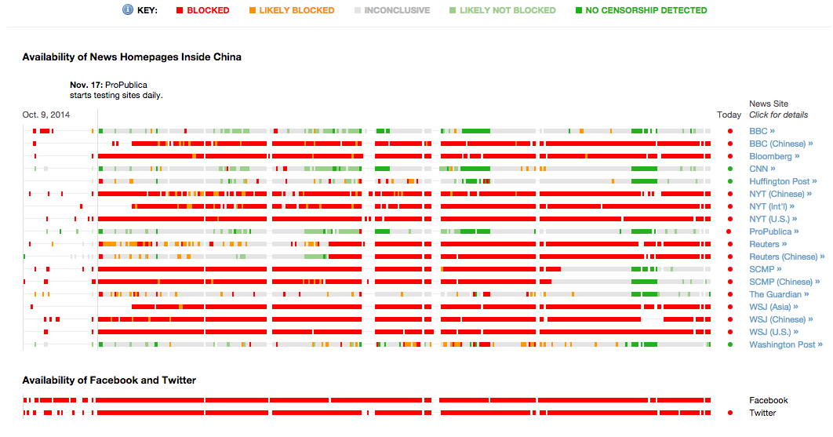
End-User Exploration
https://projects.propublica.org/firewall/
Notes:
Exploratory visualization can also be for the end user of a visualization.
For example this dashboard of homepages that are blocked in China. It presents an overview but doesn’t tell a story per se … allows user to explore different pages over time, drill in for more details.

Slide 13
Exploratory Visualization
Discovery
An iterative process of view creation, sense-making, and refinement
Generating and verifying hypotheses
Asking questions and trying to answer them by constructing the data and views that would lead to an answer
Notes:
At a low level, we accomplish the exploratory process through a series of visual search and query actions.

Slide 14
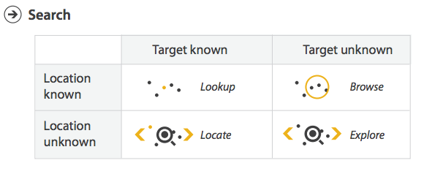
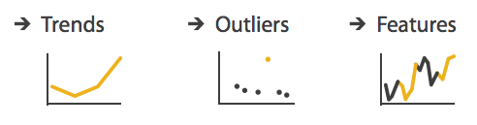
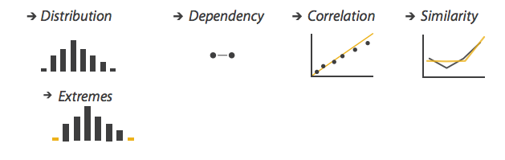
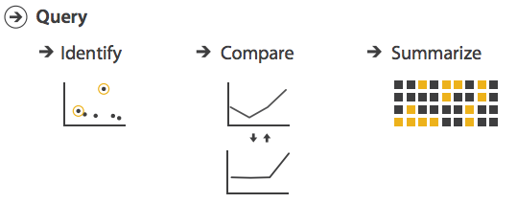
Exploration Goals
Image Credit: T. Munzner. Visualization Analysis & Design
Notes:
Trends: increases, decreases, peaks, troughs, plateaus
Outliers: things that don’t fit in
Features: any structure of interest

Slide 15
Three Stages of Exploratory Vis
Data & View Specification
Comparison, filtering, highlighting, sorting
Map data to shape, color, position, size, etc.
Custom programming or interactive tools (Tableau!)
View Manipulation
Interaction to select, navigate, coordinate, organize the display
Process & Provenance
Annotation, recording

Slide 16
Comparison
The central activity of analytic exploration
Ranking: Is A > B
Bar charts are great!
Deviation
Comparison to some expected value
What fraction of B is A?
Part-to-whole graphs: pie charts, stacked bars
How does A compare to itself over time?
Line charts
Juxtaposition & Superposition
Notes:
Comparisons: nominal, ranking, part-to-whole, deviation, time-series

Slide 17
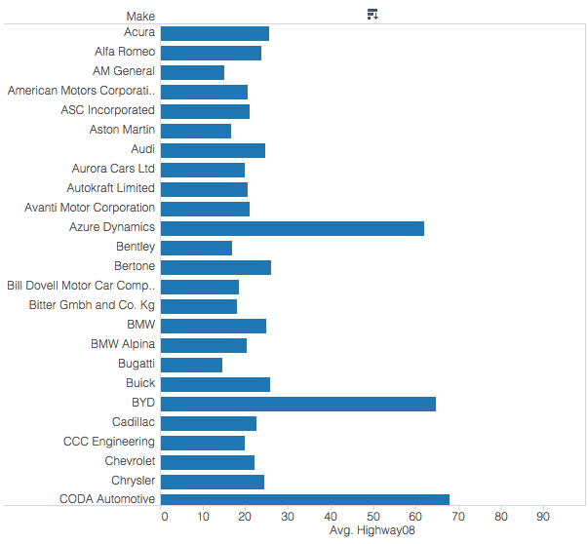
Notes:
Basic graphs like bar graphs support comparison by creating visual queries for quick perception of those comparisons.
So here’s some data that I created to map the make of a car and the average highway MPG for that make. It was created in Tableau.

Slide 18
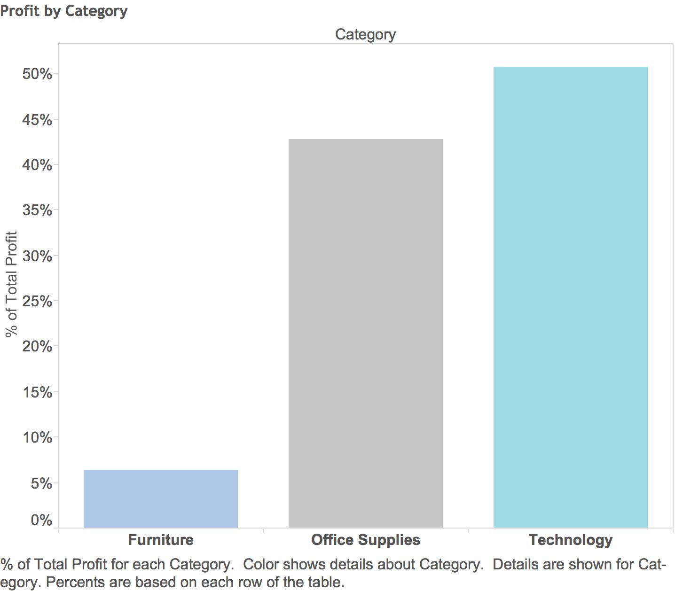
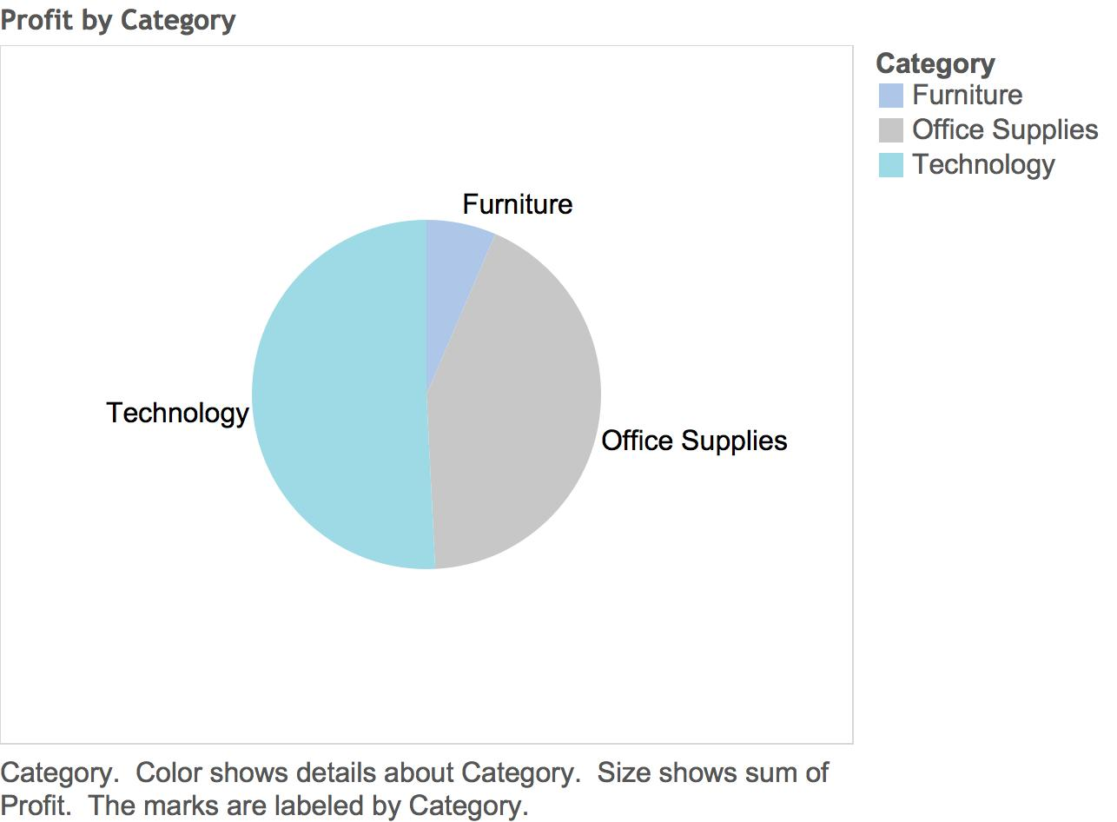
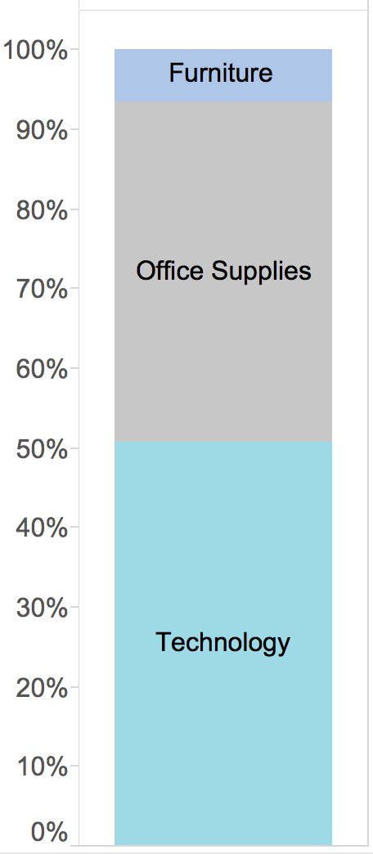
Fraction of Whole

Slide 19
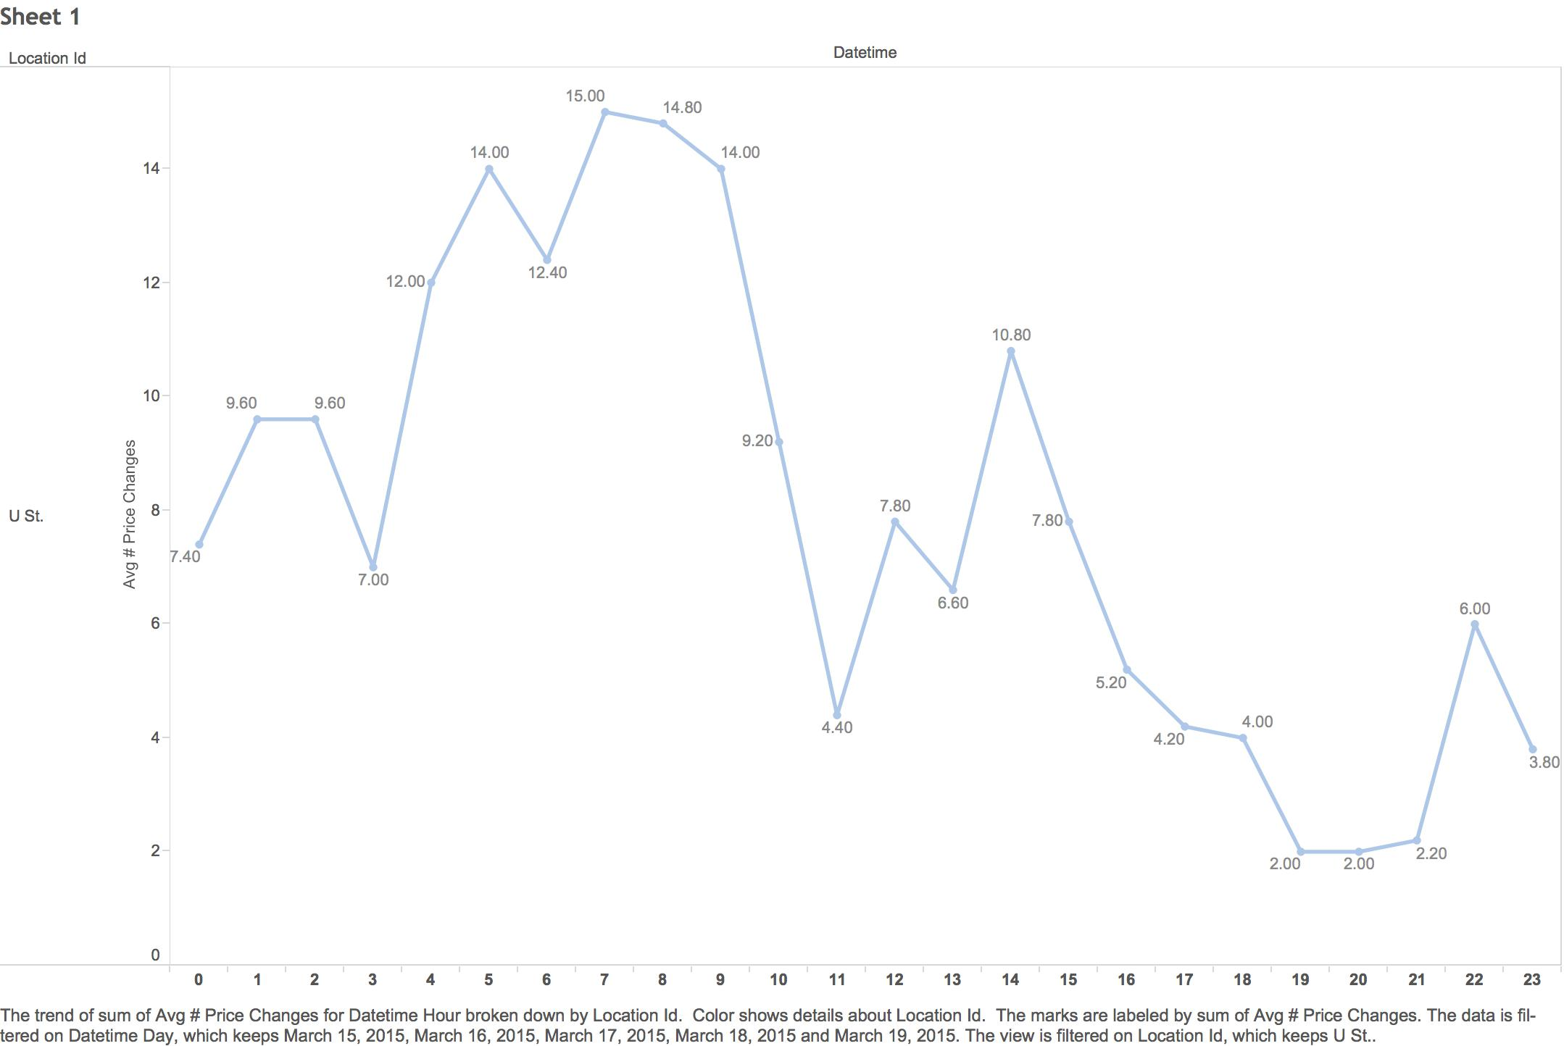
Over Time
Notes:
Comparison over time is one of the more types of comparisons.
You can also do comparisons by superposition, and juxtaposition

Slide 20
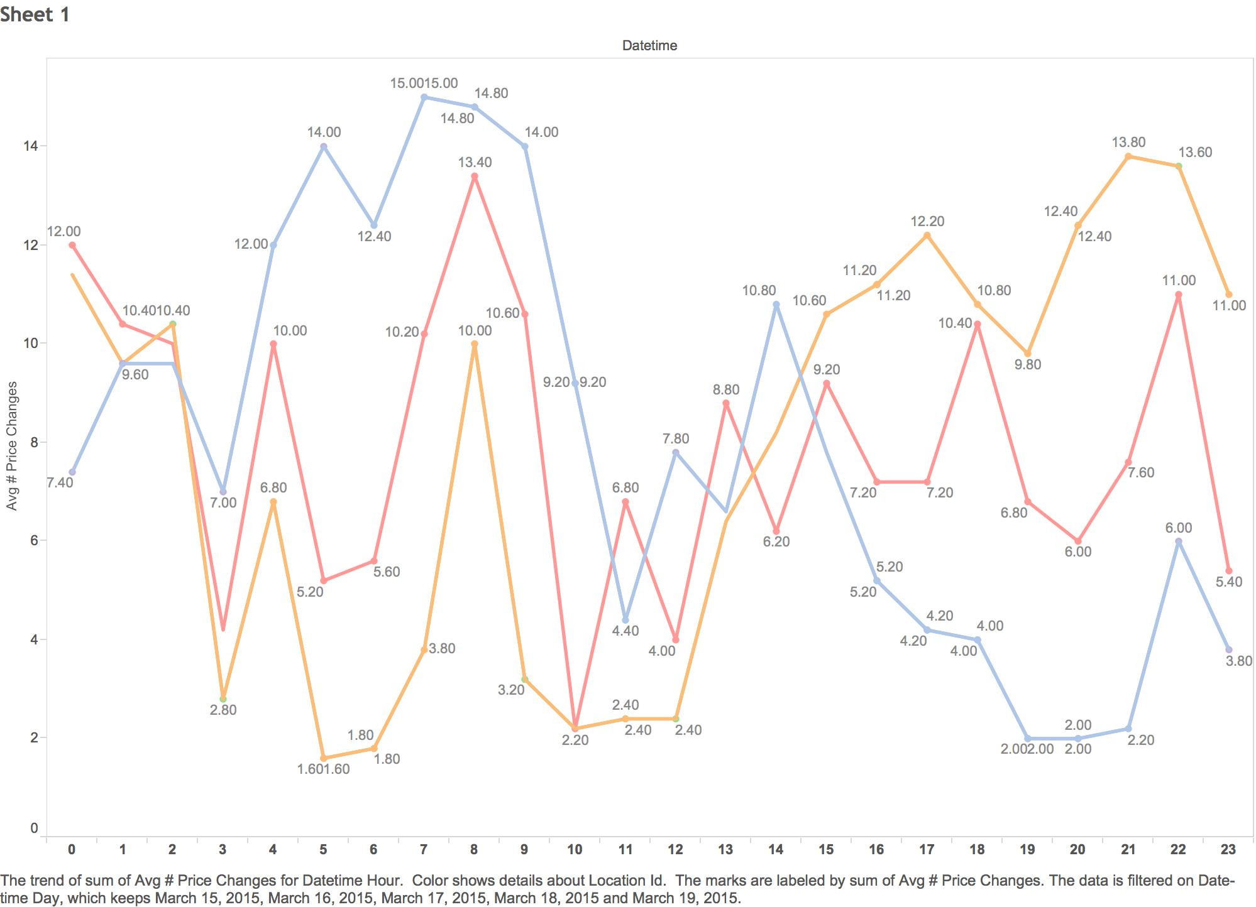
Superposition
Notes:
Comparison over time is one of the more types of comparisons.
You can also do comparisons by superposition, and juxtaposition

Slide 21
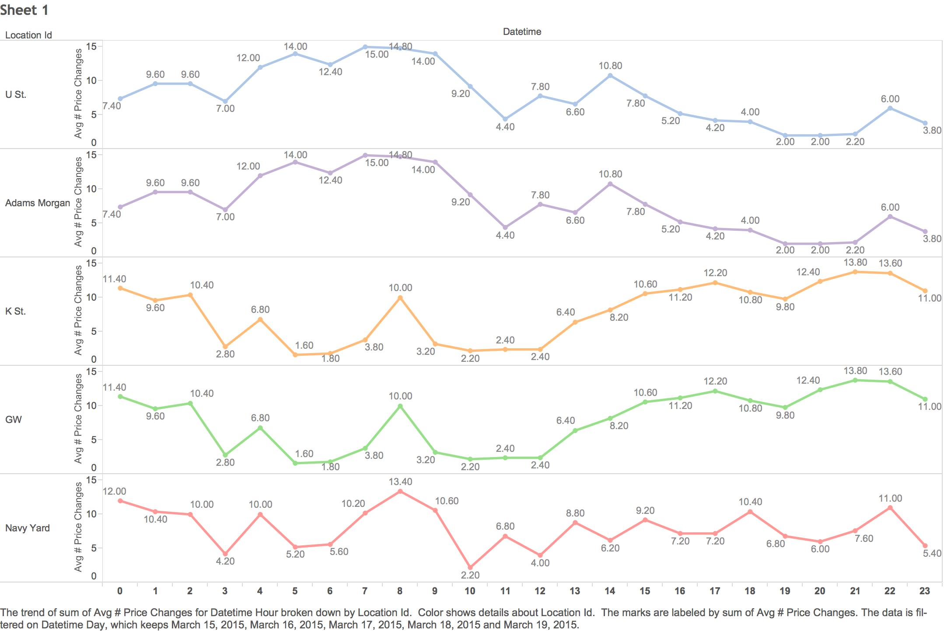
Juxtaposition
Notes:
Comparison over time is one of the more types of comparisons.
You can also do comparisons by superposition, and juxtaposition

Slide 22

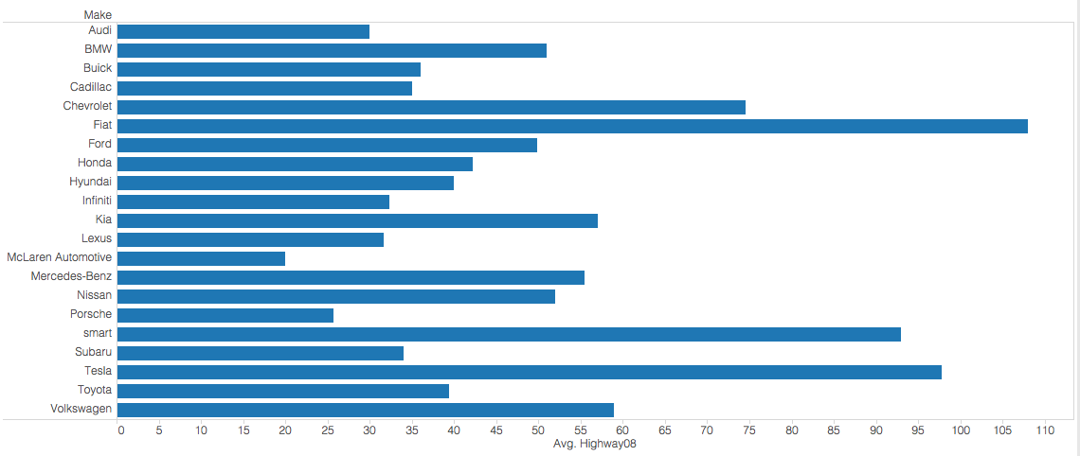
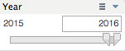
Data Reduction
Filter
Focus by removing irrelevant information
e.g. different time ranges, isolate specific categories

Slide 23

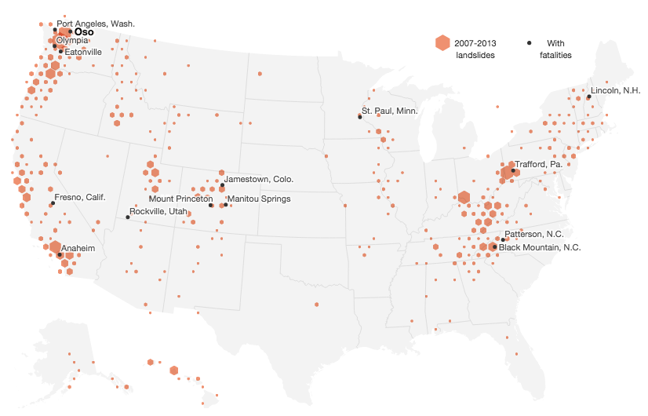
Data Reduction
Aggregate
Combine or group values
http://news.nationalgeographic.com/news/2014/04/140422-surveying-american-landslides-interactive/
Notes:
Landslides since 2007. One way to aggregate on maps is to use a hexagonal bin… So instead of showing individuals dots which would get hard to read because they would cluster or be difficult to distinguish.

Slide 24
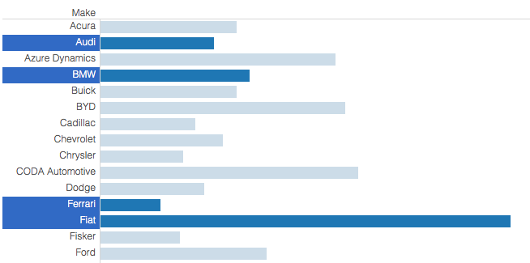
Highlighting
Cause some data to stand out while not removing other data
See highlighted data in context
Notes:
And within that, maybe we want to focus on just those brands that are european.
Filtering removes data from view, whereas highlighting keeps everything in view and helps you keep the context.

Slide 25
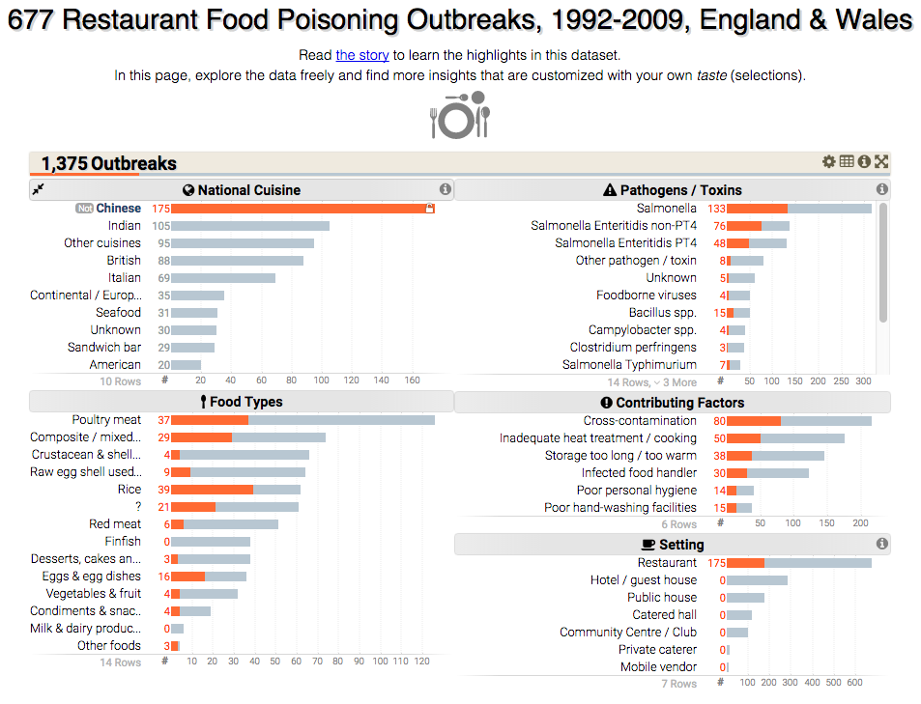
http://keshif.me/demo/food_poising_outbreaks

Slide 26
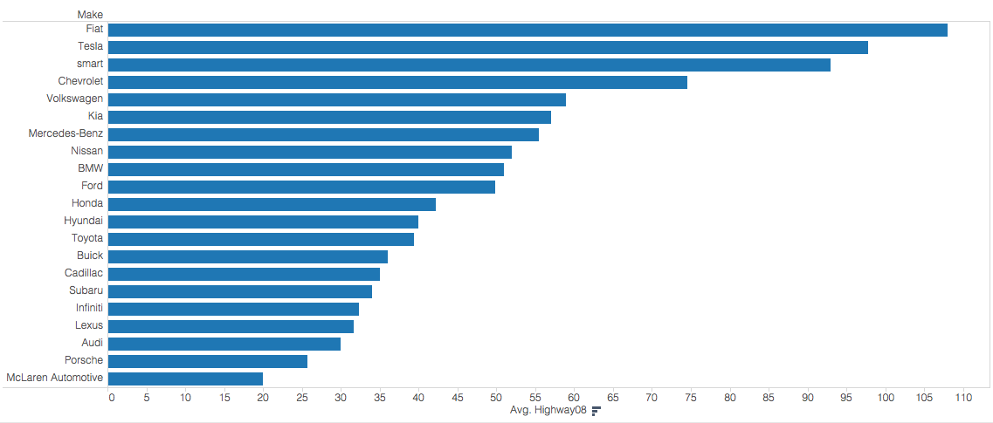
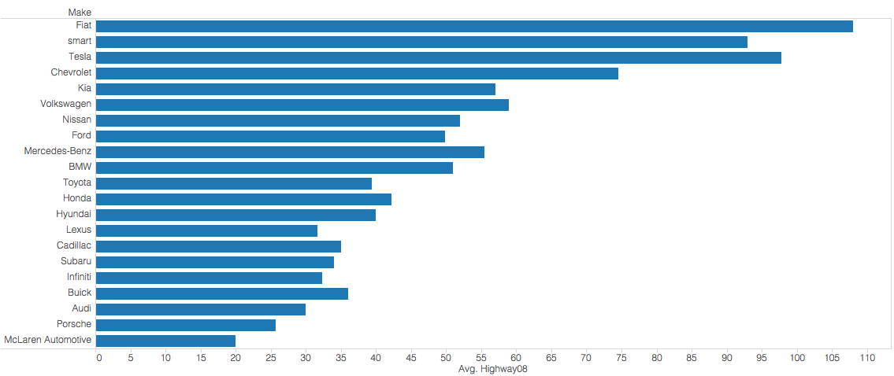
Sorting & Ordering
Ordering can show trends or clusters of values
Order by different value, than that plotted
Notes:
A quick sort shows us that Fiat, Tesla, and Smart are in a category all their own.
But if we order by a different value (city MPG in this case) then we see that in fact the Smart car has slighly lower highway MPG, but better city MPG

Slide 27
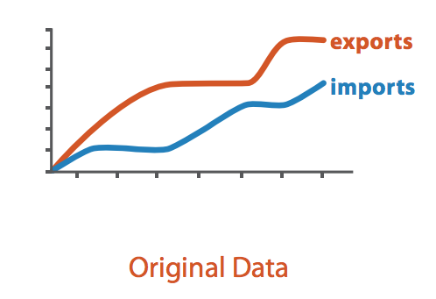
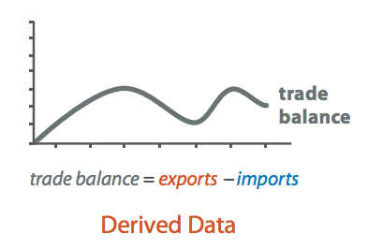
Deriving Data
Calculating new variables, e.g. rates, sums, differences
Normalizing, log transformations
Mean, median, variance
Statistical relationships (e.g. a trend line)
Predictions based on models
Image Credit: T. Munzner. Visualization Analysis & Design
Notes:
Sometimes encoding a variable directly makes the difference between them more apparent.

Slide 28
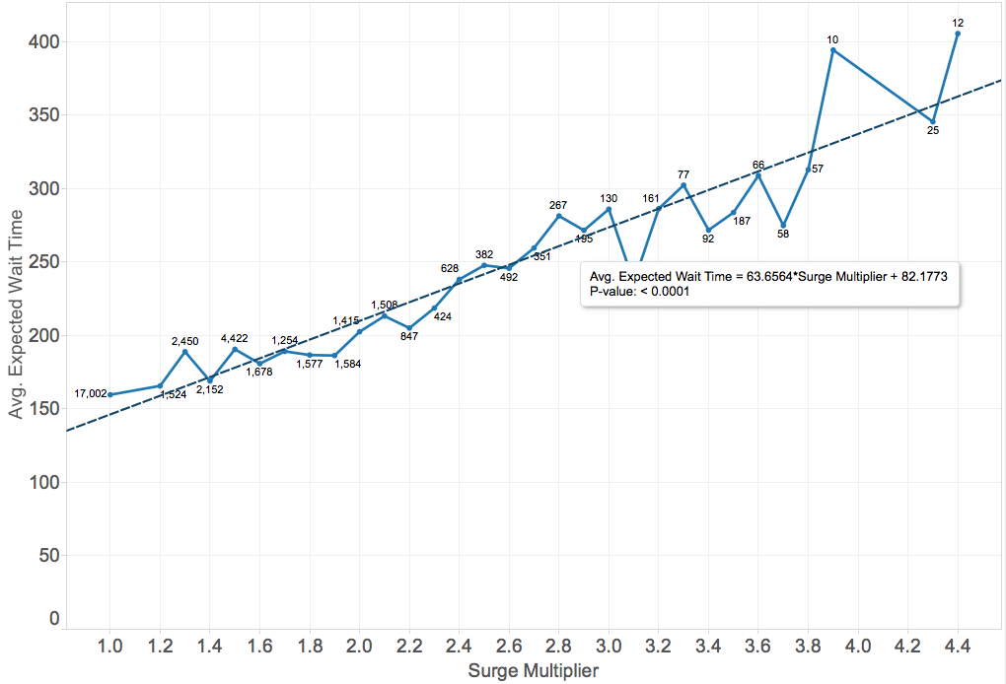
Notes:
Calculated trend line.

Slide 29
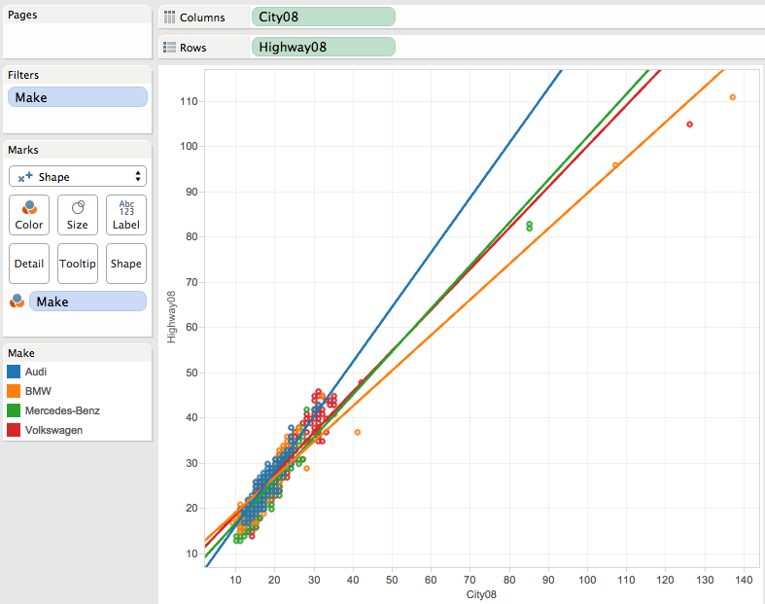
Notes:
Trend lines are derived to show the relationships and to compare those relationships between the different makes. When you hover over that you can see the slope and offset for those lines.

Slide 30
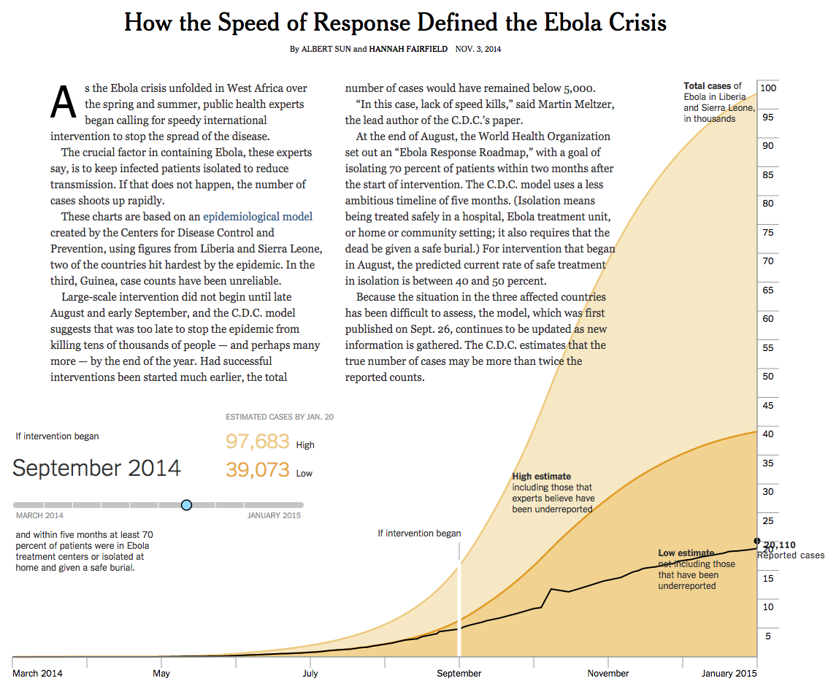
http://www.nytimes.com/interactive/2014/11/04/health/visuals-ebola-model.html?_r=0
Notes:
They derive (or really predict with their model) future data points. Models are another way that data can be derived. We also need to be careful about signalling to the end-users how *reliable* derived data is. Interesting in this example is that user can interact with the model and see how the vis changes as a result.

Slide 31
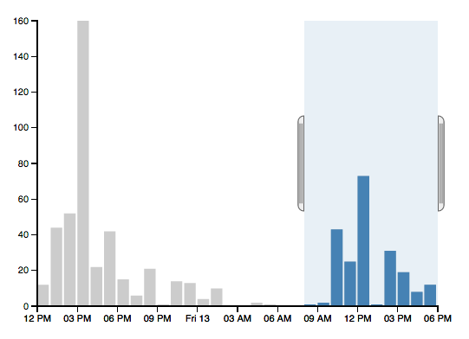
Selection
Items or regions
Highlight
Drill down for details
Hover, click, region selection (boxes or lassos)
Often feed into filtering operations
Notes:
Filtering of a range of items on a timeline

Slide 32
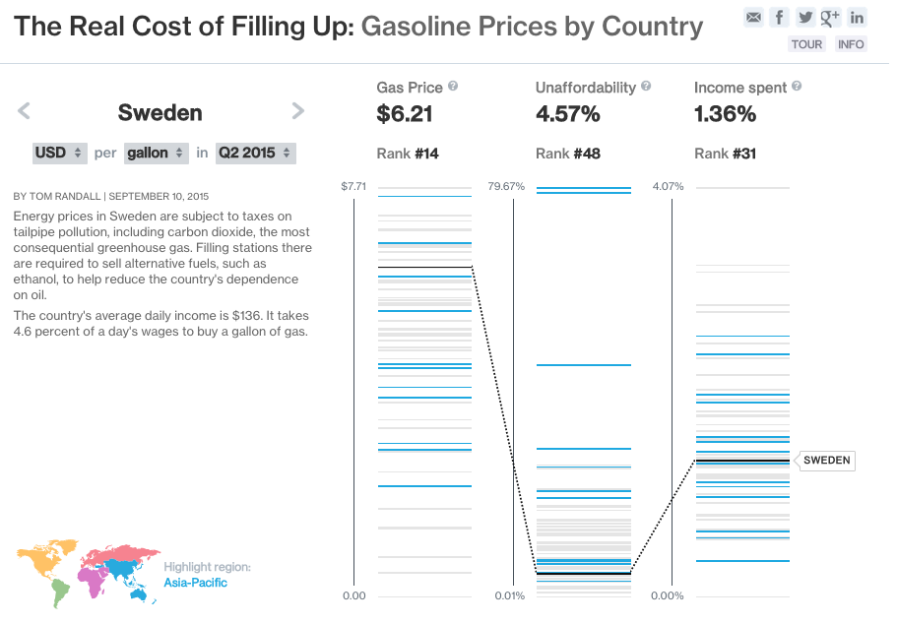
http://www.bloomberg.com/visual-data/gas-prices/20152:Sweden:USD:g
Notes:
Parallel coordinates of three values.
Selection showing both an individual point (Sweden), that becomes highlighted via line and label. As well as a selected region which is highlighted by color.

Slide 33
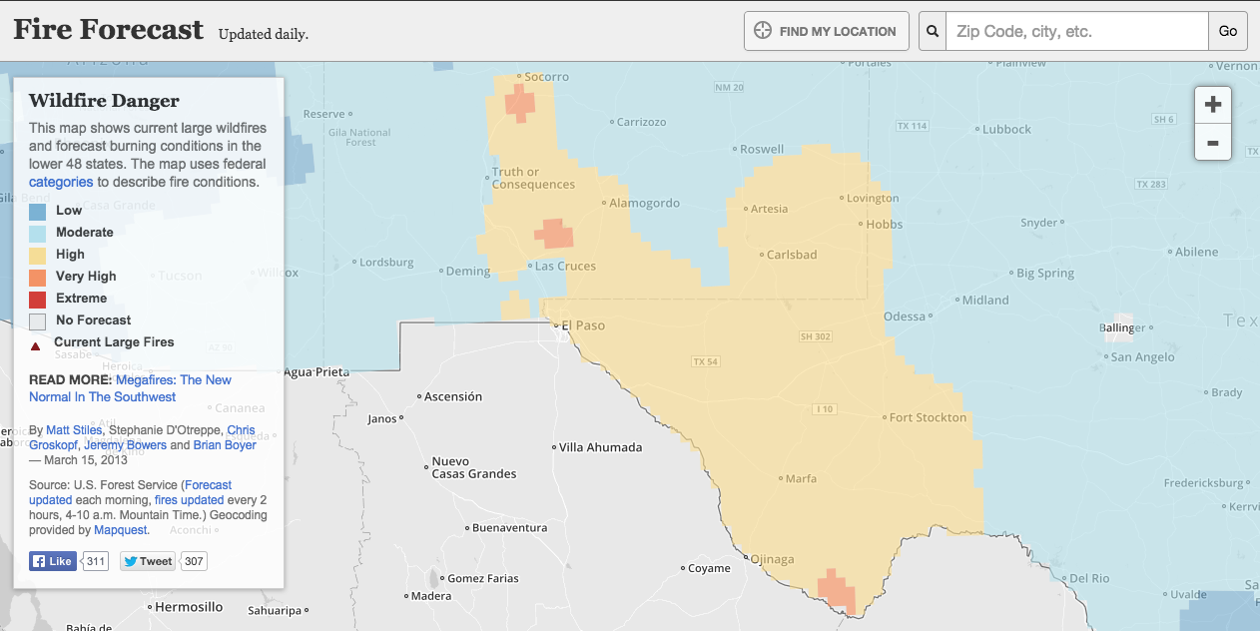
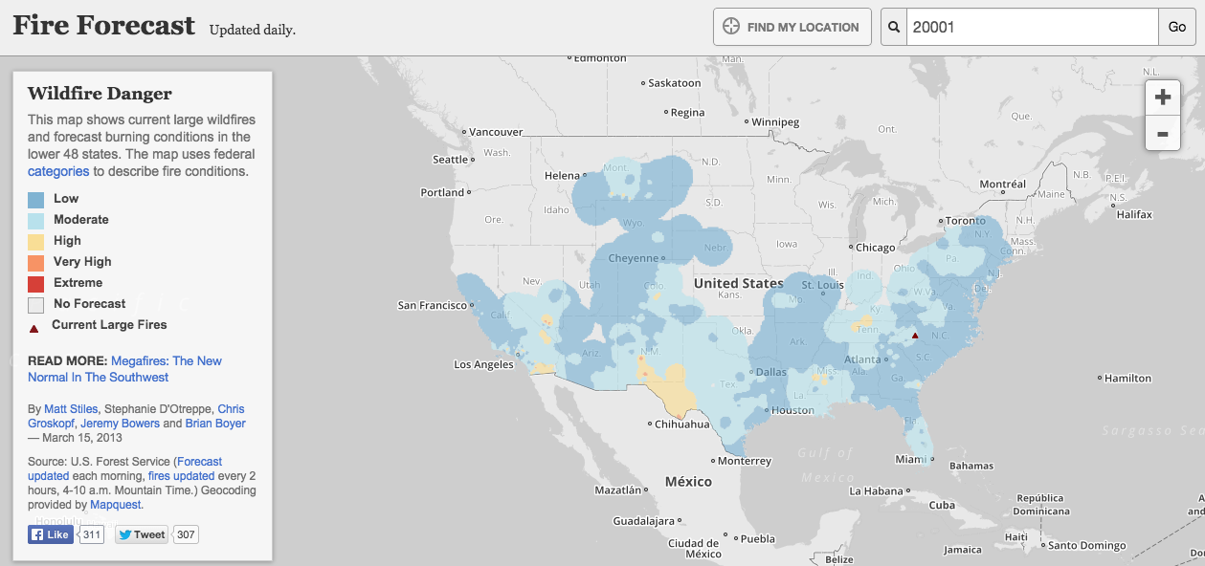
Navigation
“Overview first, zoom and filter, details on demand”
Panning, zooming, scrolling
http://apps.npr.org/fire-forecast/
Notes:
A map makes a good example where you start with a broad overview, and then visual information makes you curious about a particular sub region that you then zoom into to get additional details.
You can also think of zooming as a form of filtering

Slide 34
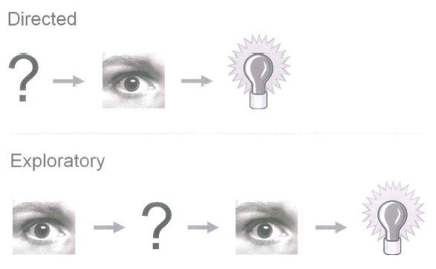
Directed vs. Exploratory Navigation
Notes:
Few makes a disctinction between directed analytic navigation and exploratory analytic navigation, depending on whether you come in with a question or not. It’s interesting to try it both ways.

Slide 35
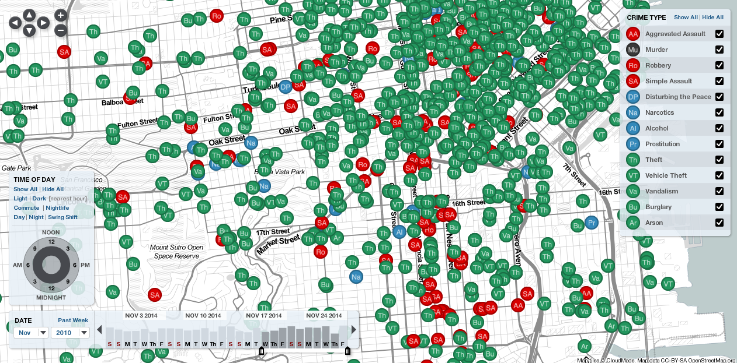
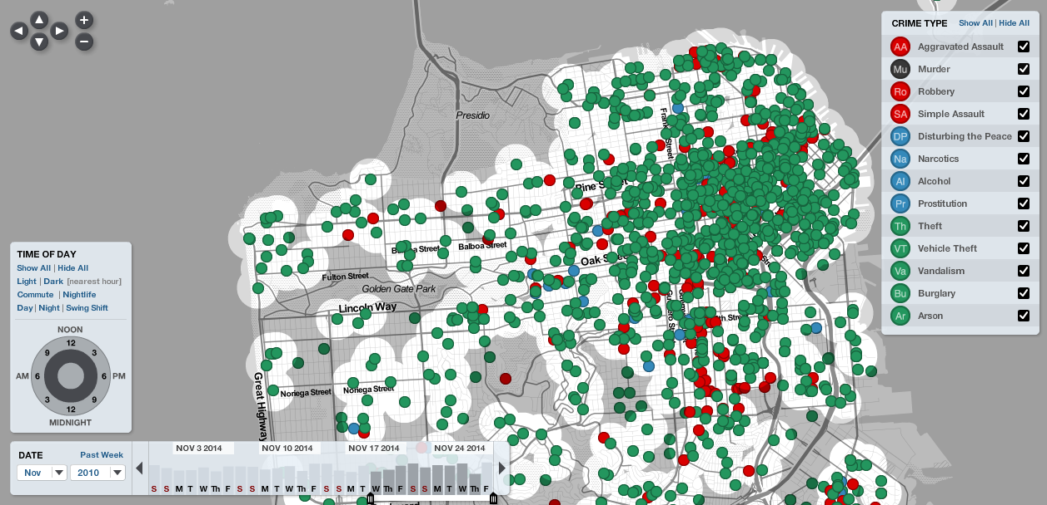
Semantic Zooming
http://sanfrancisco.crimespotting.org/
Notes:
SF Crimespotting
Another example of navigation and the idea of semantic zooming, as you zoom in objects gain additional labels.

Slide 36
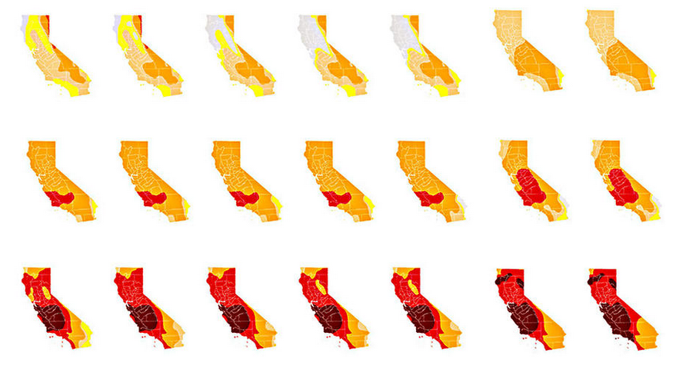
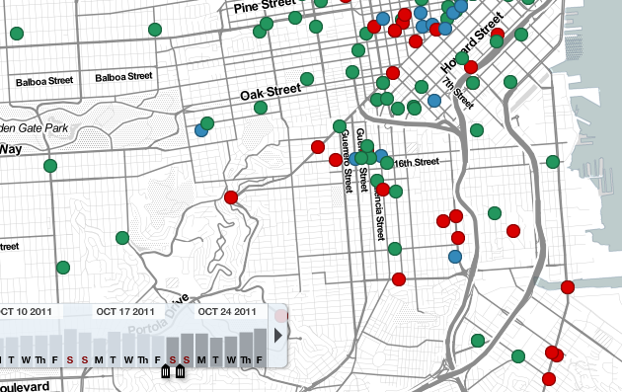
View Coordination
Dashboards with many charts linked via interaction
Select item in display and see related items in another (brushing)
Small multiples (Trellis plots) to aid comparison
http://www.latimes.com/science/la-me-g-california-drought-map-htmlstory.html
Notes:
Each graph only differs according to some categorical variable.
Can have horizontal, vertical, or matrix layout

Slide 37
Notes:
Brushing: select a subset of items in one graph with results in items being highlighted in other views.

Slide 38
View Organization
Dashboard Design
Layout of a collection of visualizations, legends, filter widgets, etc.
Put related views adjacent to minimize eye movements
Place most prominent view in upper left
Etc.

Slide 39
Process & Provenance
Annotate
Record, organize, communicate insights (to yourself or others) gained during exploration
Point at areas of interest; graphical annotations
Textual annotations
Record
What was the path you took to insight?
Keep a notepad, or text file and take assiduous notes as you ask questions and try different configurations, mappings, or filters.
Bookmarks: store view state for later

Slide 40


Slide 41
Tableau Tutorial
Dashboards, Storypoints, Online Publishing
Diabetes Dataset
https://github.com/comp-journalism/UMD-J479D-J779D-Fall2016/blob/master/Data/diabetes_data.xlsx

Slide 42
Tableau Exercise
Get in pairs of two people
Download the WaPo data tracking fatal police shootings:
https://github.com/washingtonpost/data-police-shootings/blob/master/fatal-police-shootings-data.csv
Explore the data in Tableau
Find 2-3 different insights by exploring (Remember: compare, filter, aggregate, highlight, sort, derive, select, navigate; ask questions)
For each insight, make a chart that clearly shows the insight, write a clear title, and a1-2 sentence caption that explains the insight.
Output the chart as a .png (be sure to include the title and caption) and email to nad@umd.edu

Slide 43
Questions?

